Slide 1

Capstone Project - 1
Google Play store Apps Review Analysis
Team Members
Utsav Ponda
Sivaramaguhan S
Vikramaditya Sah
Suhas Jagadish

Slide 2
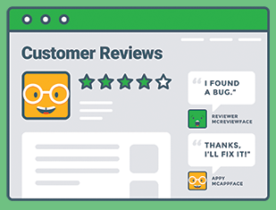
Let’s find out which apps most succeeded to influence our daily lives.
Problem Definition.
Data Cleaning Process.
Key Factors of top 5 Engaged and Successful Category apps.
Data Exploration using Graphical representation.
Conclusion.

Slide 3
Problem Definition
“The Play Store apps data has enormous potential to drive app-making businesses to success. Actionable insights can be drawn for developers to work on and capture the Android market. Each app (row) has values for catergory, rating, size, and more. Another dataset contains customer reviews of the android apps. Explore and analyze the data to discover key factors responsible for app engagement and success.”

Slide 4
1.1 Project Abstract
Since the reign of digital revolution, we are more connected to internet. In the fast changing economy, business, organisations, jobs, and most of our work is transformed online. we can demand almost anything with single click.
Apps are become an important part of life, variety of apps are available in Google play store from playing games to ordering food online.
According to Statista Report upto 1st quarter 2021, there are more than 3.4 million apps in Google Play store.
But how much apps are we actually using in daily life ?
we can atmost count on fingertips, right ?
Hence, one can easily realise the competition and success ratio.

Slide 5
2. Data Cleaning Process.
In this Project, We are provided with two (.csv) files i.e., PlayStoreData.csv and User Reviews.csv for the data analysis.
We have imported Numpy, Pandas, Matplotlib, and Seaborn libraries of python for data cleaning, data operation, data visualisation process respectively.
Load both (.csv) files in the separate dataframes, df_playstore for Play Store Data.csv and df_reviews for User Reviews.csv.
First, we will analyse the data contents of both files i.e., rows, columns, data content, data type format, size of data and check for Nan values.
The metadata information of both data frames can be obtained by using DataFrame.info()

Slide 6
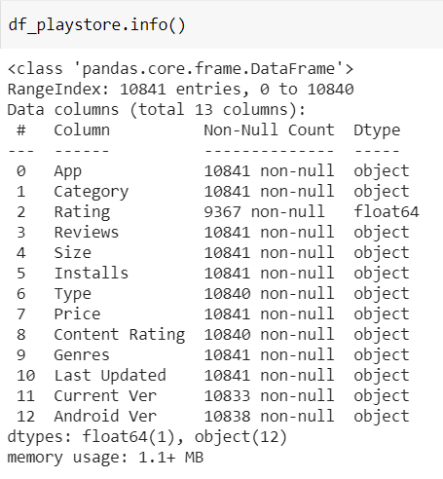
MetaData : PlayStoreData.csv

Slide 7
Description of Field Data in Playstore :
Attributes Description
App Application
Category Category of the application
Rating Overall user rating the app
Reviews Number of users review for the app
Size Size of the app
Installs Number of user downloads/Installs
Type Paid or free
Price Price of the app
Content Rating Age group of app Children/Adult
Genres App’s genres

Slide 8
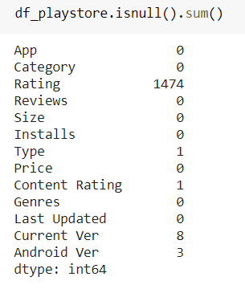
Cleaning NaN values in Playstore Data frame
Rating : There are 1474 NaN values, replaced with median rating : 4.1.
Type : There is only 1 NaN value, replaced with ‘Free’ since more than 92.6% are ‘Free’ apps.
Content Rating : There is only 1 NaN value so replaced with ‘Everyone’.
.

Slide 9
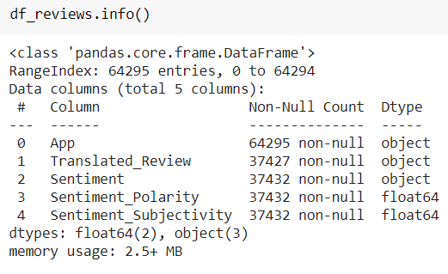
MetaData : User_Review.csv

Slide 10
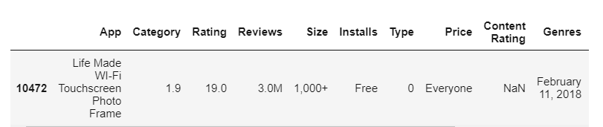
Exploring and cleaning field values by analysing CSV file
There are Spaces in Column names such as ‘Content Rating’ , ‘Last Updated’, ’Current Ver’ and ‘Android Ver’ We are removing spaces, to avoid errors while data processing.
df_playstore.columns=df_playstore.columns.str.replace(' ','')
We dropped columns such as ‘Last Updated’, ’Current Ver’ and ‘Android Ver’ because it has no practical insights to contribute the problem definition.
We observed Missing Values in row 10472 for category column so dropped it from the dataset.

Slide 11
Data Cleaning in Playstore
During the process of visual representation of graph with respect to our analysis, we need numerical values for plotting.
Data in some of the column was in string type which was needed for plotting , Like :
In Reviews column we had “M” character.
In Installs column we had “+” sign.
In Price column we had “$”.
We removed these special character with an empty string (“”) and by using .replace() function and converted in to float data type using .astype() function, to make it useful for the plotting of the values in the data set.

Slide 12
3. Key Factors of top 5 Engaged and Successful Category apps.
To know the practical insight, apps must qualify above threshold benchmark based on below factors :
Installs : No. of Installs of individual app should be greater than mean of installs of entire apps in data set.
Reviews : No. of Reviews of individual app should be greater than mean of installs of entire apps in data set.
Most Engaging Apps by Categories : The apps which have more reviews, have the higher user interaction and can be termed as most engaging so we have taken percentage ratio of review to installs will give most engaging apps by categories.
We observed that categories like ‘GAME’ , ‘Family’, ‘Health and Fitness’, ‘Tools’ are some the prominent categories in the data set.

Slide 13
Continued...
Most Successful Apps by Categories : The Apps which are filtered as per above points 1 and 2 along with highest number of installs will make most successful apps.

Slide 14
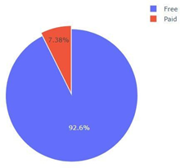
4. Data Exploration using Graphical representation
4.1 Free and Paid apps contribution :
This pie chart shows that percentage of distribution of free Apps are 92.6% compare to 7.38% which are paid apps in all the dataset

Slide 15
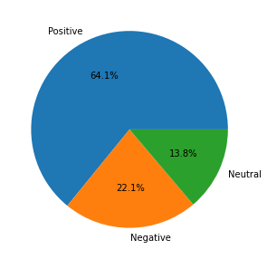
Sentiments distribution over all apps :

Slide 16
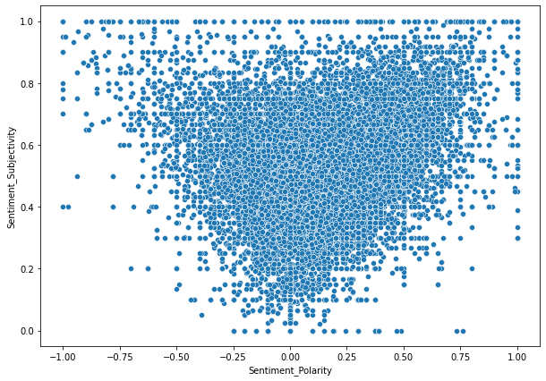
Sentiment_subjectivity Vs Sentiment_Polarity :

Slide 17
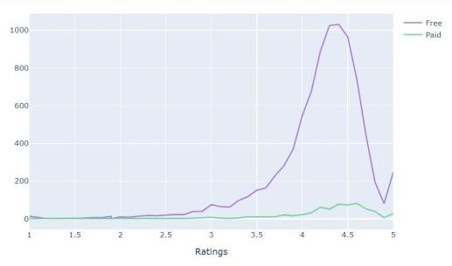
Ratings of Free Vs Paid Apps :
Free apps are the most rated apps on the Google Play Store compared to Paid Apps

Slide 18
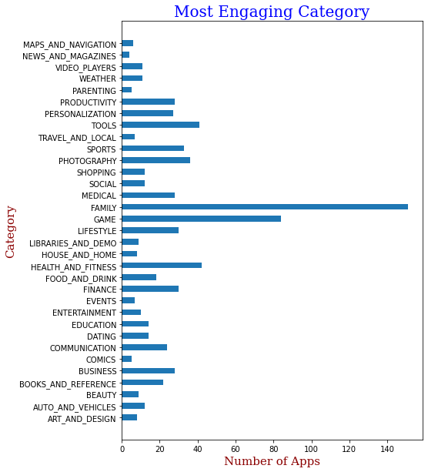
Most Engaging Categories :
The chart shows that the number of engaging category in the entire dataset.This can be achieved with the help of number of installs with ratings.

Slide 19
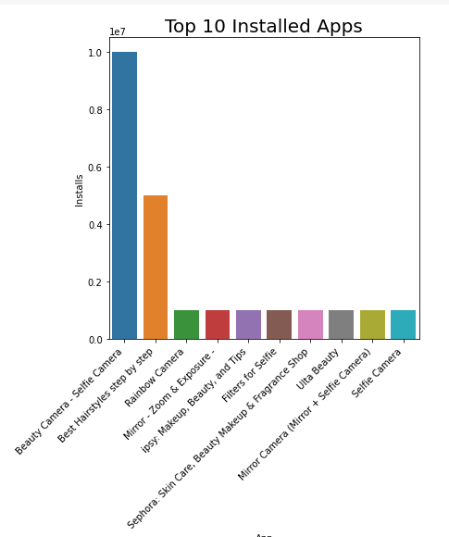
Most Successful Apps:

Slide 20
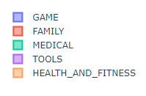
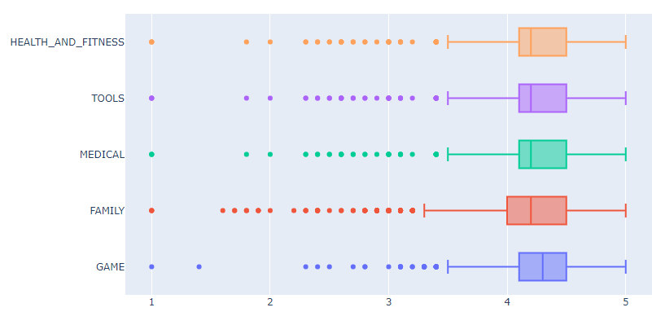
Box Plot - Ratings Vs Top 5 Categories :

Slide 21
Outliers detection using Box plot :
Outliers are the data point that is distant from other similar points.They may be due to variability in the measurement or may indicate experimental errors.
If possible outliers should be excluded from dataset.However,detecting that anomalous instances might be very difficult,and is not always possible.
Using boxplot is one of the way to detect outliers.In our project,we use to find outliers in reviews with each category.Here,TOOLS,MEDICAL and GAME having MIN value at 3.5 MAX at 5 and LQR,MEDIAN,UQR values lies between 4.2 and 4.5
Whereas in HEALTH AND FITNESS LQR,MEDIAN,UQR is between 4 and 4.5 MIN value is 3.3.

Slide 22
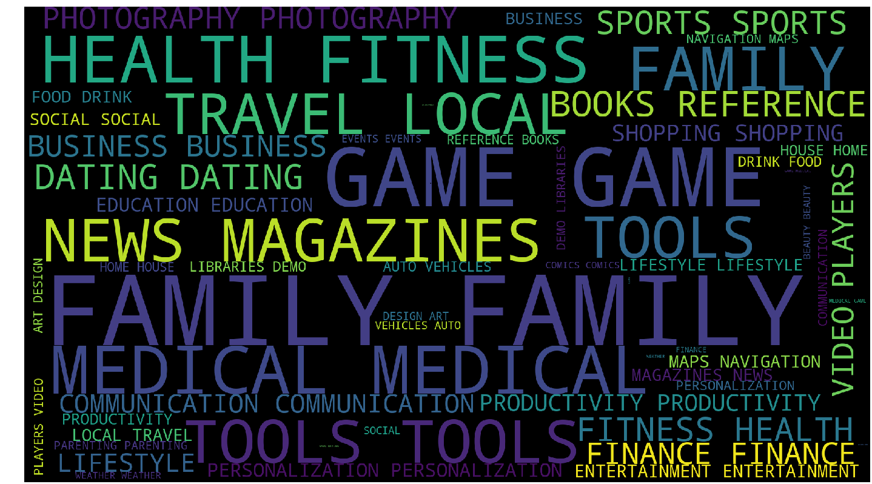
Word Cloud:
This chart shows the word cloud having all the names which are present in the category columns.

Slide 23
Conclusion :
The dataset contains immense possibilities to improve business values and have a positive impact.It is not limited to the problem taken into consideration for this project.Many other interesting possibilities can be explored using this dataset.
Identifying the categories and stats of the most installed apps.
Exploring whether it’s free or paid and sentiment of the review comments.
Most of the trending apps(installs) are from the categories like GAME,COMMUNICATION and TOOL even though the amount of available categories are twice as much lesser than the category FAMILY.The trending of these apps are most probably due to their nature of being able to entertain or assists the user.
jsjhjhsh

Slide 24
Conclusion continued...
Even though apps from the categories like GAME, SOCIAL, COMMUNICATION and TOOLS of having the highest amount of installs, rating and reviews are reflecting the current trend of Android users, they are not even appearing as category in the top 5 most expensive apps in the store (which are mostly from FINANCE and LIFESTYLE). As a conclusion, we learnt that the current trend in the Android market are mostly from these categories which either assisting, communicating or entertaining apps.

